Slide 1


Monthly EXPENSE CALCULATOR USING JAVA SWING
SAVEETHA SCHOOL OF ENGINEERING
SAVEETHA INSTITUTE OF MEDICAL AND TECHNICAL SCIENCES
Submitted by
S . Gayathri
(192110183)
Department of CSE
Saveetha School of Engineering
SIMATS, Chennai – 602105
Project Guide
Dr. Bhuvaneshwari
Professor
Department of CSE
Saveetha School of Engineering
SIMATS, Chennai – 602105

Slide 2
Table of contents
Abstract.
Introduction.
Software requirements.
Existing
Proposed
Use Case Diagram
Technology Used
Outputs.
Conclusion .
Future enhancement
References

Slide 3
ABSTRACT
The Monthly Expense Calculator aims to simplify and optimize the often intricate task of monitoring personal finances. By leveraging intuitive interfaces and seamless integration with banking and financial platforms, users can effortlessly input and categorize their expenditures in real-time. Gone are the days of cumbersome manual tracking; the MEC automates the process, offering users a comprehensive overview of their spending habits.
Key features of the system include dynamic budget allocation, allowing users to set personalized spending limits for different expense categories. Moreover, advanced analytics tools empower individuals with insightful reports and visualizations, facilitating informed decision-making and fostering financial literacy.

Slide 4
INTRODUCTION
The Monthly Expense Calculator (MEC) concept is driven by a comprehensive set of aims and revolutionize the landscape of personal finance management. Rooted in addressing the objectives, tailored to individuals face in tracking and optimizing their monthly expenditures, the MEC embodies a commitment to efficiency, accuracy, and user convenience.
Real-Time Monitoring of Expenses
Timely Insights for Decision-Making
Cloud-Based Storage for Remote Accessibility
Flexibility and Accessibility
Advanced Analytics Tools
User-Friendly Interfaces

Slide 5
SOFTWARE REQUIREMENTS
The MEC shall implement user authentication for accessing the system.
Users shall have the capability to record expenses for various categories such as groceries, utilities, and entertainment.
The MEC shall provide summary reports of spending trends over time, including graphical representations for better visualization.
The MEC shall support multiple users accessing the system simultaneously without experiencing significant performance degradation.
The user interface of the MEC shall be developed using intuitive design principles.

Slide 6
EXISTING
A personal finance app tailored for individual users, offering expense tracking features along with budget management tools.
An expense management software designed for small businesses, providing capabilities for tracking expenses, generating reports, and managing budgets.
A web-based expense tracker focused on freelance professionals and self-employed individuals, offering invoicing and expense categorization functionalities.
A mobile expense management app integrated with banking services, enabling users to track expenses, set budget goals, and receive personalized financial insights.
An open-source expense tracking platform suitable for nonprofit organizations, featuring customizable expense categories, donation tracking, and budget planning tools.

Slide 7
PROPOSED
Implement expense categorization functionality for organizing spending into different categories.
Develop a user-friendly interface with intuitive navigation for ease of use.
Introduce budgeting features to allow users to set and track financial goals.
Enhance expense tracking capabilities by integrating with bank accounts and credit cards.
Implement customizable reporting tools for generating detailed expense reports.
Introduce reminders and alerts for upcoming bills and financial commitments.

Slide 8
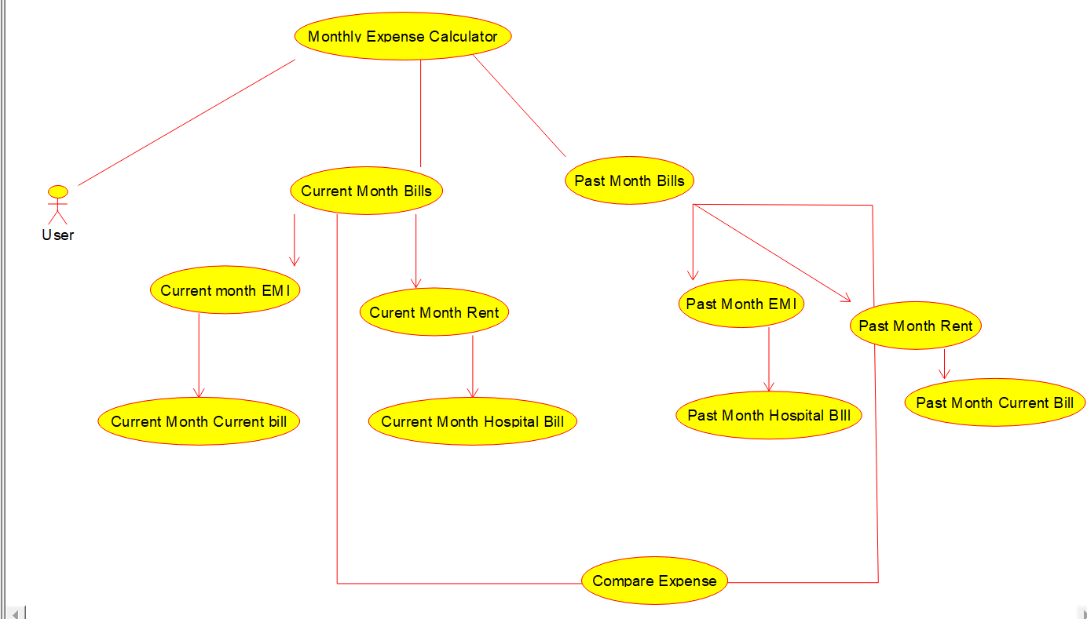
USE-CASE DIAGRAM

Slide 9
TECHNOLOGY USED
The Monthly Expense Tracker, developed using Java Swing technology, offers a robust and user-friendly solution for efficiently managing personal finances. Leveraging Java Swing's platform-independent graphical user interface (GUI) toolkit, the system ensures accessibility and consistency across different operating systems.
Java Swing components are employed to create an intuitive and interactive interface, enabling users to effortlessly navigate and perform expense-related tasks. The use of JFrame, JPanel, JButton, and other Swing components ensures a visually appealing and responsive user experience.

Slide 10
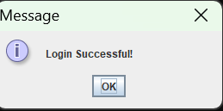
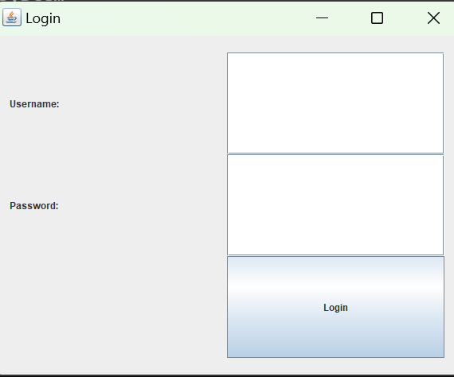
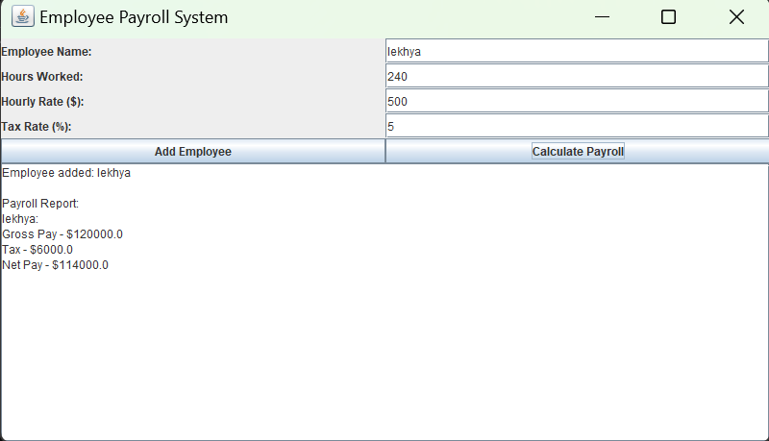
OUTPUTS

Slide 11
CONCLUSION
The implementation of the proposed Monthly Expense Calculator represents a significant advancement in personal finance management, surpassing the limitations of manual tracking methods. Scalability of the system ensures its adaptability to evolving financial needs, making it a sustainable solution for individuals and businesses alike.
Furthermore, its seamless integration with existing systems enables smooth data flow across different financial platforms, fostering consistency and reducing manual efforts in managing personal finances. Overall, the Monthly Expense Calculator revolutionizes the way individuals approach budgeting and financial planning, promoting financial stability and well-being.
Moreover, exploring opportunities for integration with emerging payment systems, such as digital wallets and cryptocurrency platforms, can provide users with more diverse and flexible options for managing their finances in an increasingly digital world

Slide 12
FUTURE ENCHANCEMENT
Integration with Financial Institutions.
Machine Learning and Predictive Analytics.
Expense Categorization and Tagging.
Expense Comparison and Benchmarking.
Mobile Application Development.
Financial Goal Setting and Tracking.
Expense Collaboration and Sharing.
Security Enhancements.
Integration with IoT Devices.
Customization and Personalization.

Slide 13
REFERENCES
https://scholar.google.com/citations?user=sXhBIVgAAAAJ&hl=en&oi=sra https://www.theseus.fi/bitstream/handle/10024/801991/THESIS.pdf?sequence=2 https://ieeexplore.ieee.org/abstract/document/10170735/ https://ieeexplore.ieee.org/abstract/document/9917982/ https://scholar.google.com/citations?user=f2TZYp4AAAAJ&hl=en&oi=sra https://ijresonline.com/assets/year/volume-10-issue-3/IJRES-V10I3P108.pdf https://www.theseus.fi/handle/10024/785937 https://www.academia.edu/download/53337467/Manchanda_Angad.pdf https://www.irjmets.com/uploadedfiles/paper/issue_4_april_2022/21604/final/fin_irjmets165 1132467.pdf https://dl.ucsc.cmb.ac.lk/jspui/handle/123456789/4424

Slide 14

MONTHLY EXPENSE CALCULATOR

